Slide 1
L10.02 Dijkstra’s shortest path Algorithm
50.004 Introduction to Algorithm
Dr. Simon LUI
ISTD, SUTD

Slide 2
Objective
Bellman-Ford: O(VE), not good….
Let’s do something smarter today.
Dijkstra’s algorithm: O(V logV+E)

Slide 3
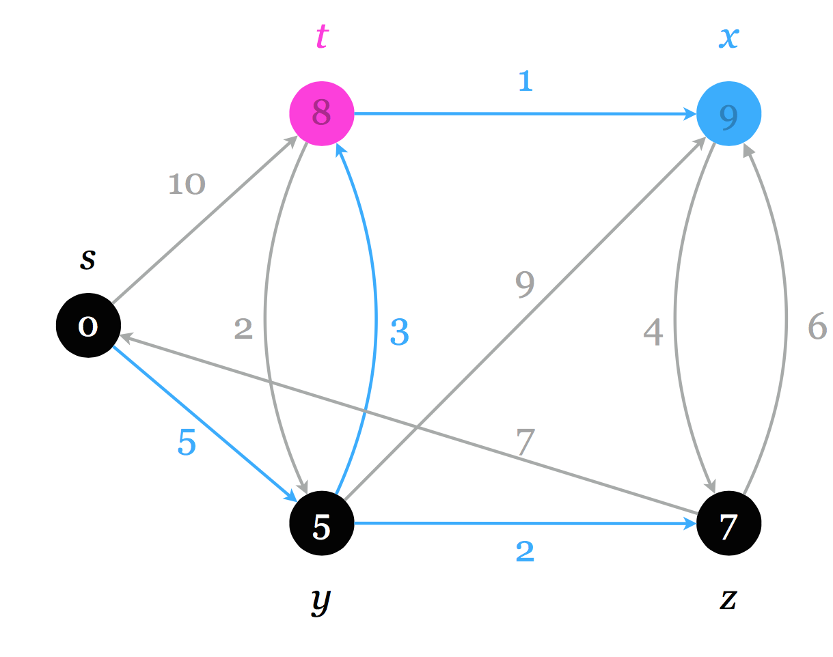
Dijkstra’s Algorithm
It can find the shortest path from s to any note
E.g. s->t=8, s->c=5, s->x=9, s->z=7

Slide 4
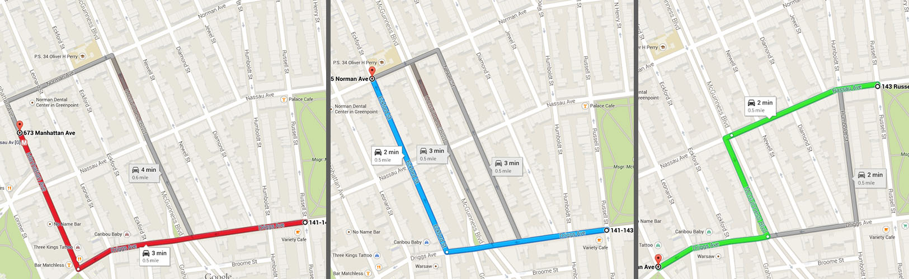
Dijkstra’s application
Google Map

Slide 5
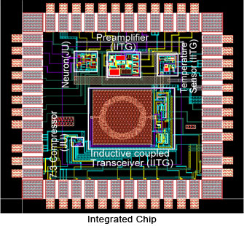
Dijkstra’s application
VLSI design

Slide 6
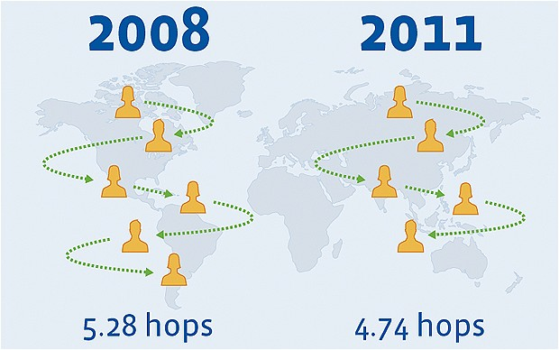
Dijkstra’s application
Verify the Six degree separation problem
Actually it is now <4. Thanks to Facebook / Instagram…

Slide 7
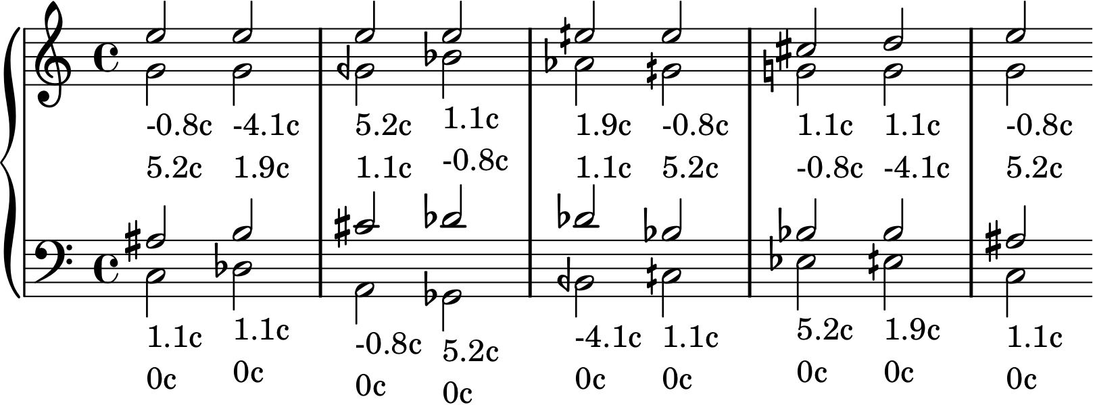
Dijkstra’s application
Automatic music arrangement (e.g. voice leading)

Slide 8

Dijkstra’s application
Road distance / railway distance
Ok…. You already expect that I will talk about myself today…
I should stop here ☺

Slide 9
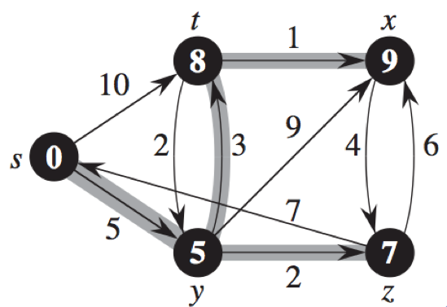
What we already know
To calculate the shortest distance, we need to perform relaxation along the shortest path tree.
But how to find the shortest path tree? We need to solve the whole problem first! (e.g. by Bellman-ford, in O(VE))
Is there any special case, so that we can
First, guess the sequence of the relaxations
hence just need to relax each edge only once?
YES! See next page

Slide 10
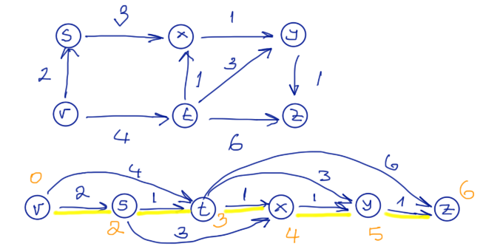
The case of Directed Acyclic Graphs (DAGs)
We can find the order of relaxations to be performed once by running topological sort!
There is no cyclic dependence to solve the Bellman equations
The result of topological sort gives the sequence of the relaxations to find the solution

Slide 11
Complexity
Topological Sort: Θ(V+E)
Graph Traversal: Θ(V+E)
one visit per node
each incoming edge relaxed exactly once
hence Θ(V+E)
Total: Θ(V+E)

Slide 12
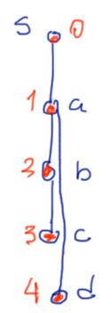
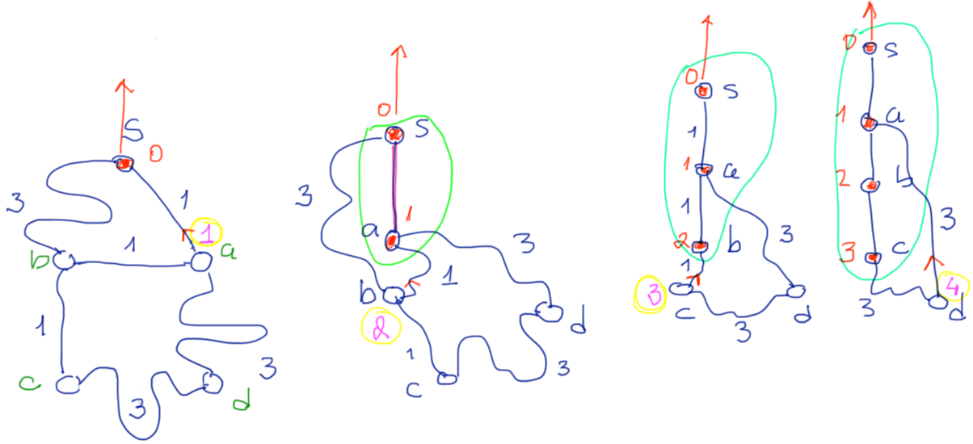
Dijkstra’s algorithm
I start lifting node s:
Because of gravity, the substring with the shortest distance will be tight…
Observe: nodes enter the set S (of nodes lifted) in the order of their
shortest distance to s through the nodes already in S
This property is exploited in Dijkstra’s algorithm!

Slide 13
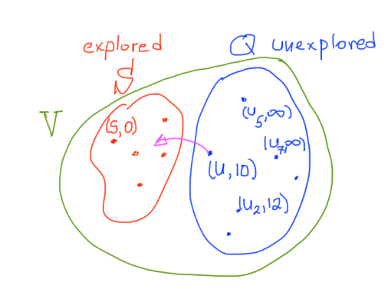
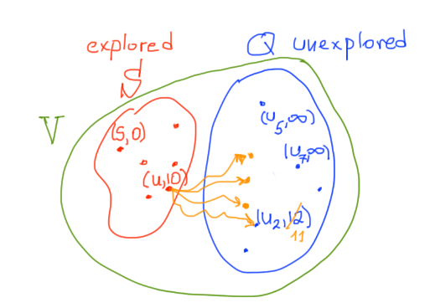
Dijkstra’s algorithm
no negative edges is allowed
Maintain a set S of nodes whose final shortest path weights have been determined
Repeatedly select nodes not in S, add them to S, relax their outgoing edges
Notes:
think of a net that connects the nodes together
Nodes enter S in order of increasing distance
I relax edges only after I bring a node in S

Slide 14
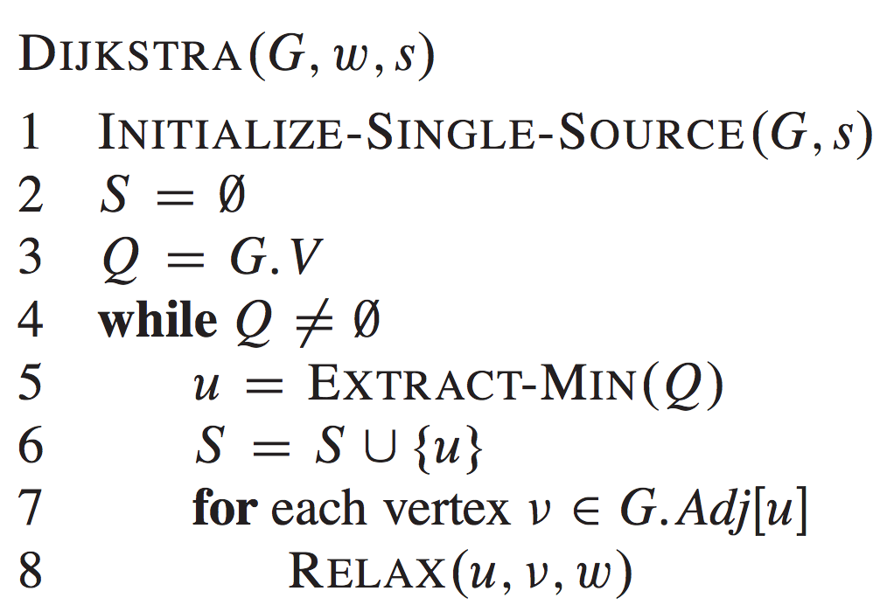
Min
Priority
Queue

Slide 15
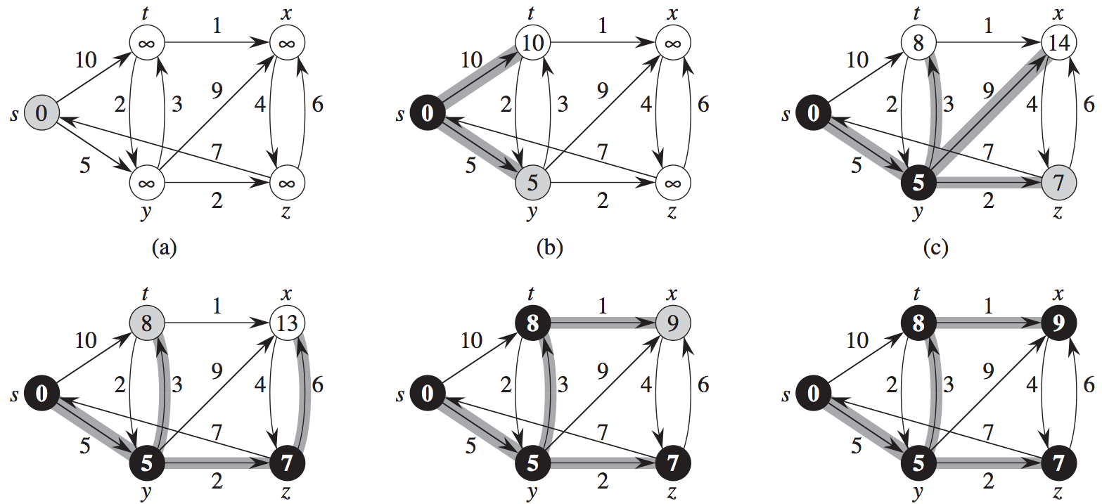
Dijkstra’s algorithm example

Slide 16
add all vertex to Queue
Extract-min()
Decrease_key()
Complexity: it performs
Θ(V) addToQueue()
Θ(V) extract-min()
Θ(E) decrease_key()
Array
x Θ(1)
x Θ(V)
x Θ(1)
= Θ(V²+E)
= Θ(V²)
Binary-heap
x Θ(logV)
x Θ(logV)
x Θ(logV)
= Θ((V+E)logV)
Fib-heap
x Θ(1)
x Θ(logV)
x Θ(1)
= Θ(VlogV+E)

Slide 17
Fibonacci heap
Min Heap: consolidate tree after each insert
Fibonacci heap: lazily defer consolidation until next delete-min()
Try it out:
http://www.cs.usfca.edu/~galles/JavascriptVisual/FibonacciHeap.html
Insert new node: No change in the heap
Delete-min: big change in the heap
A good tutorial:
http://www.growingwiththeweb.com/2014/06/fibonacci-heap.html
You don’t need to know how Fib heap works (out of syllabus)
Just need to know, by using Fib Heap, Dijkstra’s run in O(VlogV+E)

Slide 18
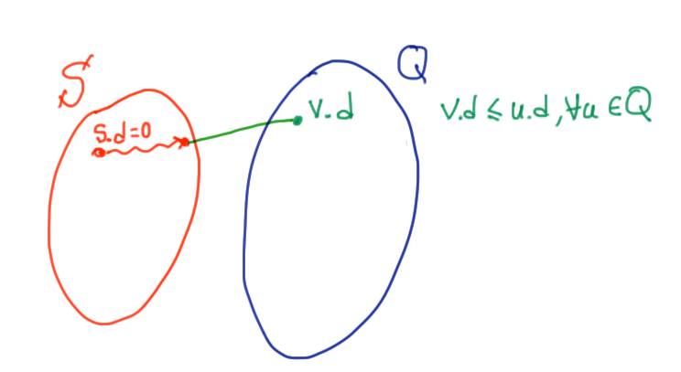
Proof of correctness of Dijkstra’s
Invariant: - The set S contains nodes which are done (shortest distance calculated)
- Now, we choose v: the minimum in Q (by extract-min(Q))
- Then, we add v to S
- we need to prove that when we add a new node v to S,
Notes:
why should δ(y) = y.d?

Slide 19
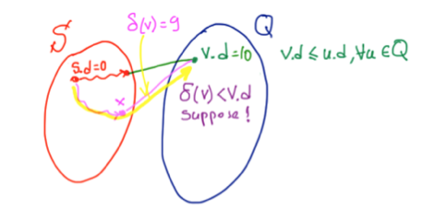
Proof of correctness of Dijkstra’s
Case 1:
v.d = 10, which is the smallest in Q Is it possible that, after we add v to S, v.d is not the shortest distance from s?
In particular, have another shorter path s->x->v = 9?
Answer: NO! It is impossible
Since (x,v) must have been relaxed in the past,
the statement “v.d = 10 which is the smallest in Q” must be wrong.
Notes:
why should δ(y) = y.d?

Slide 20
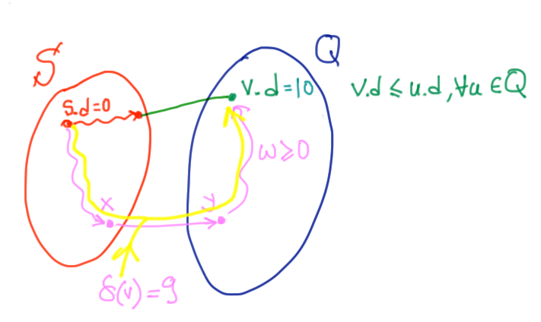
Proof of correctness of Dijkstra’s
Case 2:
v.d = 10, which is the smallest in Q Is it possible that, after we add v to S, v.d is not the shortest distance from s?
In particular, have another shorter path s->x->y->v = 9?
Answer: NO! It is impossible
Since y and v are both in Q
So, y.d must be larger than v.d
Notes:
why should δ(y) = y.d?

Slide 21
Exercise
Color[v]:
if it is W, that means set Q (unexplored)
If it is B, that means set S (explored, done)
Pred[v]: parent of v

